Slide 1
Module 3 – Classes and objects

Slide 2
Basic Terminology
A class
Class is a blueprint or template that defines the structure of an object.
Container that stores the Variables and Methods together
An object - is an instance of the class.
A Method – gives the behavior of an object.
An attribute – gives the properties of an object.
Package - collection of related classes.

Slide 3
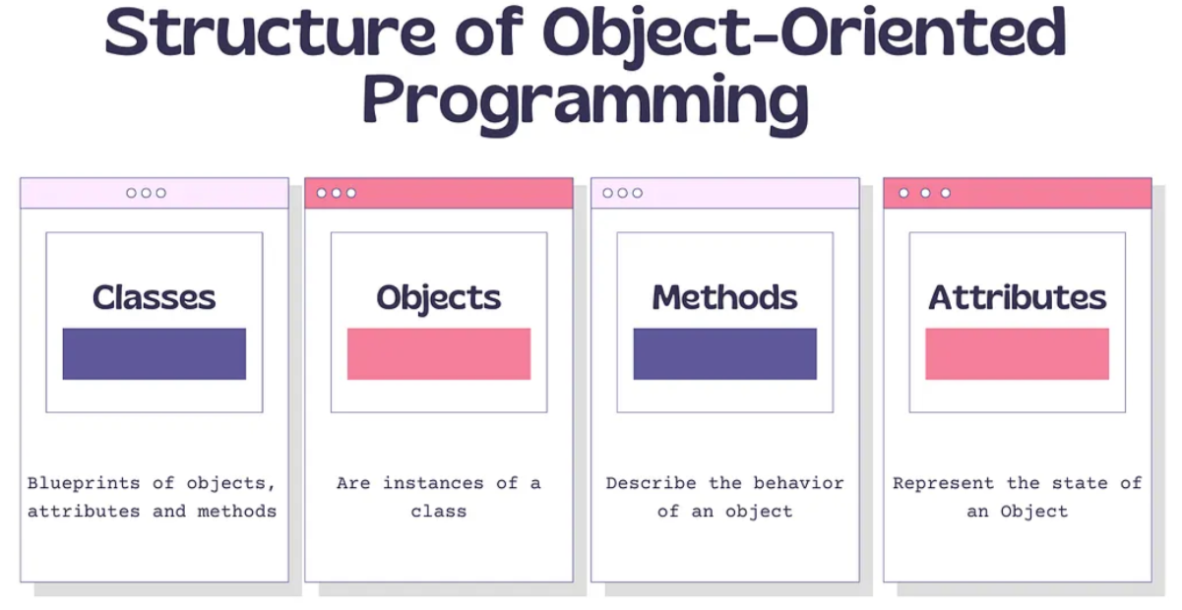

Slide 4
Components of class
Generally, class declarations consist of the following elements arranged in sequence:
Modifiers: A class can be public or has default access.
Class keyword: Class keyword is used to create a class.
Class name: The name should begin with an initial letter.
Body: The class body is surrounded by braces, { }.

Slide 5
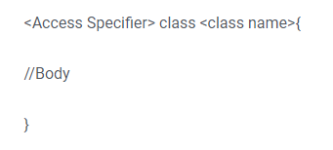
Components of class
Access Modifiers
Public
Private
Protected
Default
These access modifiers specify the accessibility and user permissions of the methods and members of the class.

Slide 6
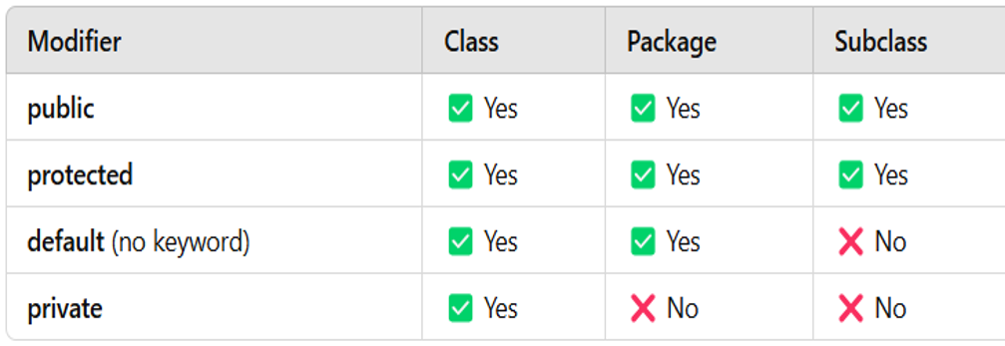

Slide 7
Class Name
This describes the name given to the class that the programmer decides on, according to the predefined naming conventions.
Body of the Class
includes executable statements.

Slide 8
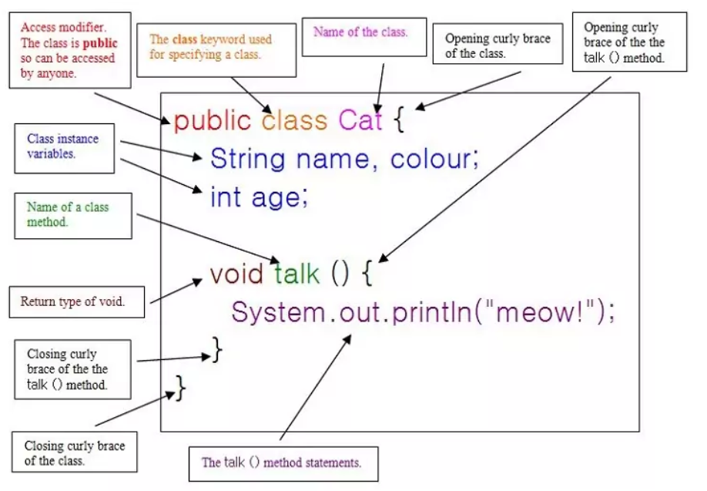

Slide 9
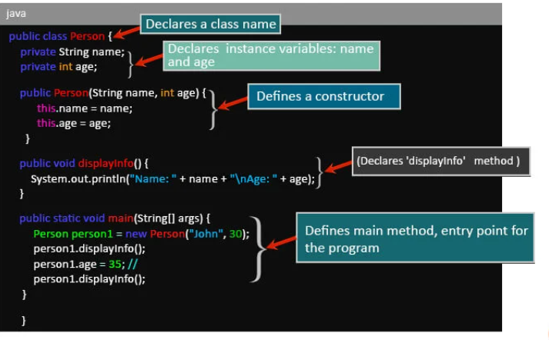

Slide 10
Non-Access Specifiers
These define special properties of classes, methods, or variables.
static: Belongs to the class instead of instances.
final: Prevents modification.
abstract: Defines an incomplete class or method.
synchronized: Used for thread safety.

Slide 11
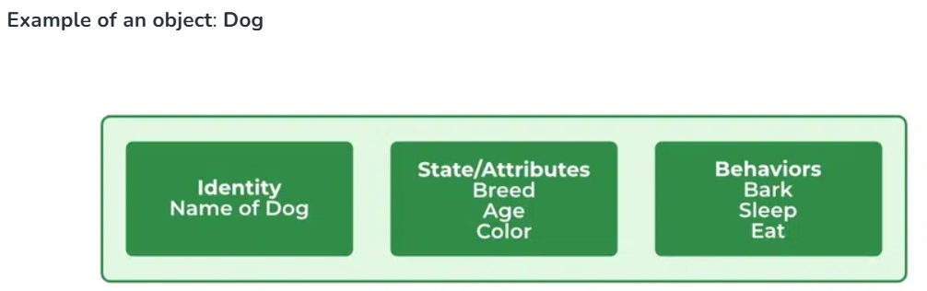
Object
State: It is represented by attributes of an object. It also reflects the properties of an object.
Behavior: It is represented by the methods of an object. It also reflects the response of an object with other objects.
Identity: It gives a unique name to an object and enables one object to interact with other objects.

Slide 12
Declaring Objects
Instance of Class
You can create any number of objects using one single class
Memory Allocation
Dog German = new Dog();
Constructor
Instance
name
Class name

Slide 13
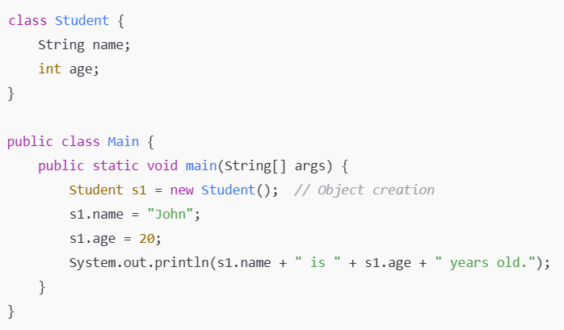

Slide 14
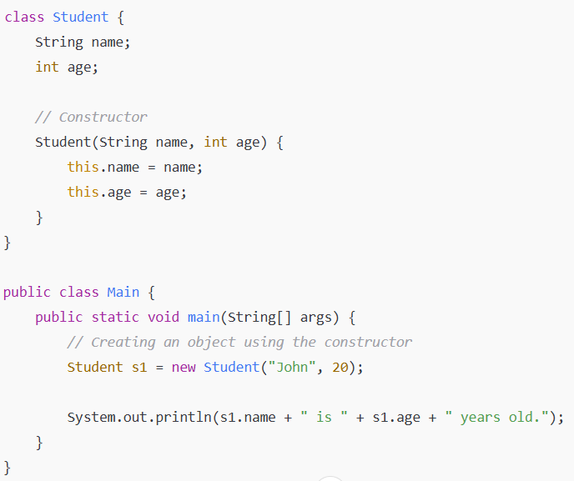

Slide 15
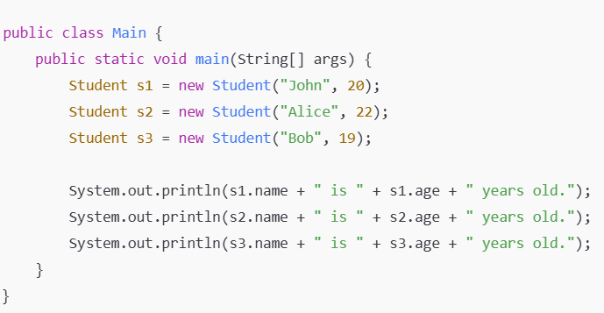

Slide 16
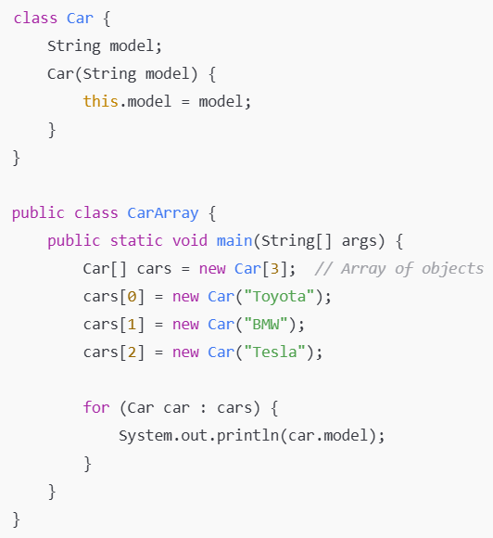
Array of Objects
Arrays can store multiple objects.

Slide 17
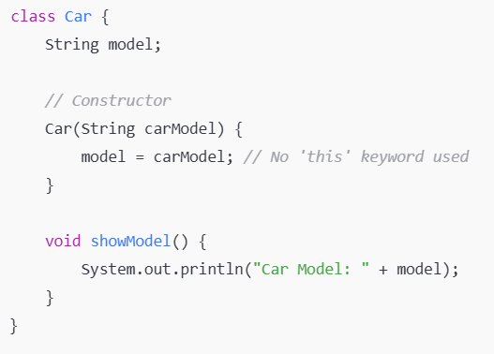
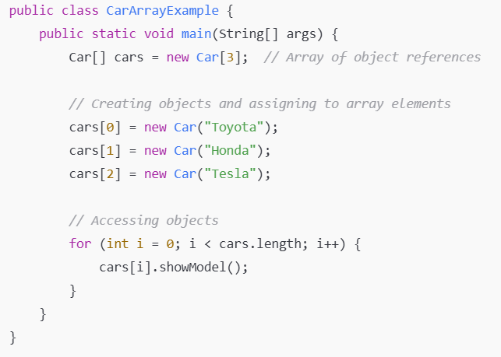
Array of Objects

Slide 18
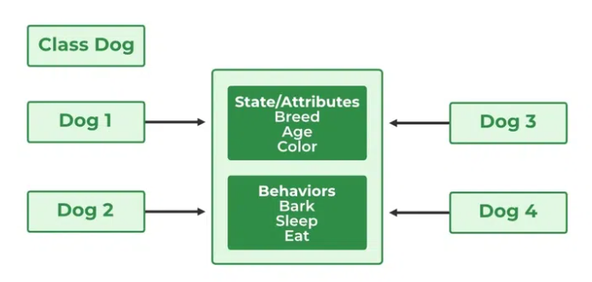
Basic Structure of a class

Slide 19
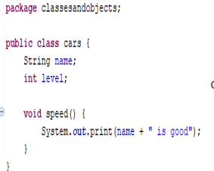
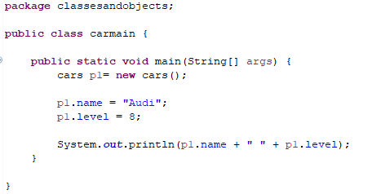
Example 1

Slide 20
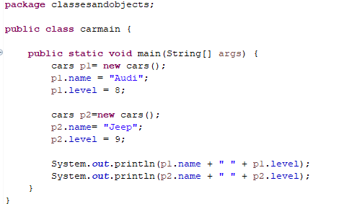


Slide 21
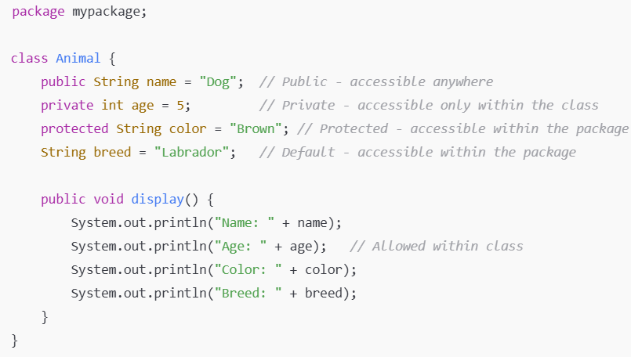

Slide 22
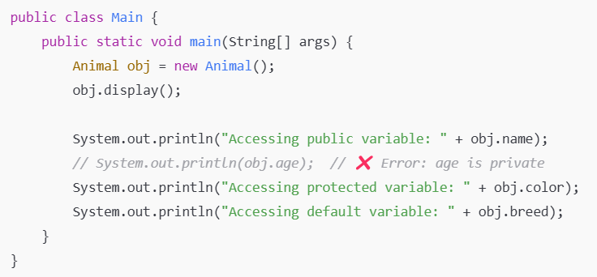

Slide 23
